Slide 1

MINI PROJECT E-Commerce Website
GLA University
Mathura-281406,INDIA
2021
SUBMITTED BY :
SHANTANU SARASWAT
ASHISH CHAUDHARY
PALASH GOYAL

Slide 2
Introduction
An E-commerce Website For Purchasing Daily Products Made To Bring Traditional Home Business To Online Mode.
The Customer Can Select Any Product like software of android and web designing.
The Users Need To Authenticate Themselves Before Accessing The Application Using Firebase Authentication Services.
The Application Will Show Ring Notification When Client Add the Product ,Remove the Product From The Cart.
It consists of Mainly Six Modules such as Home, Service, Portfolio, Testimonial, Product, Contact.

Slide 3
It is Direct Selling Online Website from Company to Customer (B2C).
It is single vendor online Farm. There is no multiple vendor online website like Amazon, Meso etc.
Add our data on Cloud Fire store.
Admin can Add the Product on Home Screen , Remove the Product and Admin can Remove the Product Of the user when the Product is unavailable.
Deploy this project on Firebase.
User can Add the Multiple products check the Subtotal of all Products on the Top right Most box.
When user remove the Product Subtotal will decrease simultaneously.
Only Offline Payment Mode is available. Admin can see the Products what the user added and then Admin will shipped the product where user wants to.

Slide 4
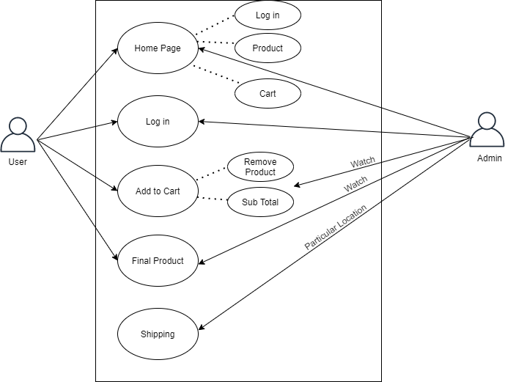
Use case Diagram

Slide 5
Zero Level DFD
Shipping Management
Customer Management
Cart
Management
Shopify
Product
Management
Payment Management
Login Management

Slide 6
VISITING Preview

Slide 7
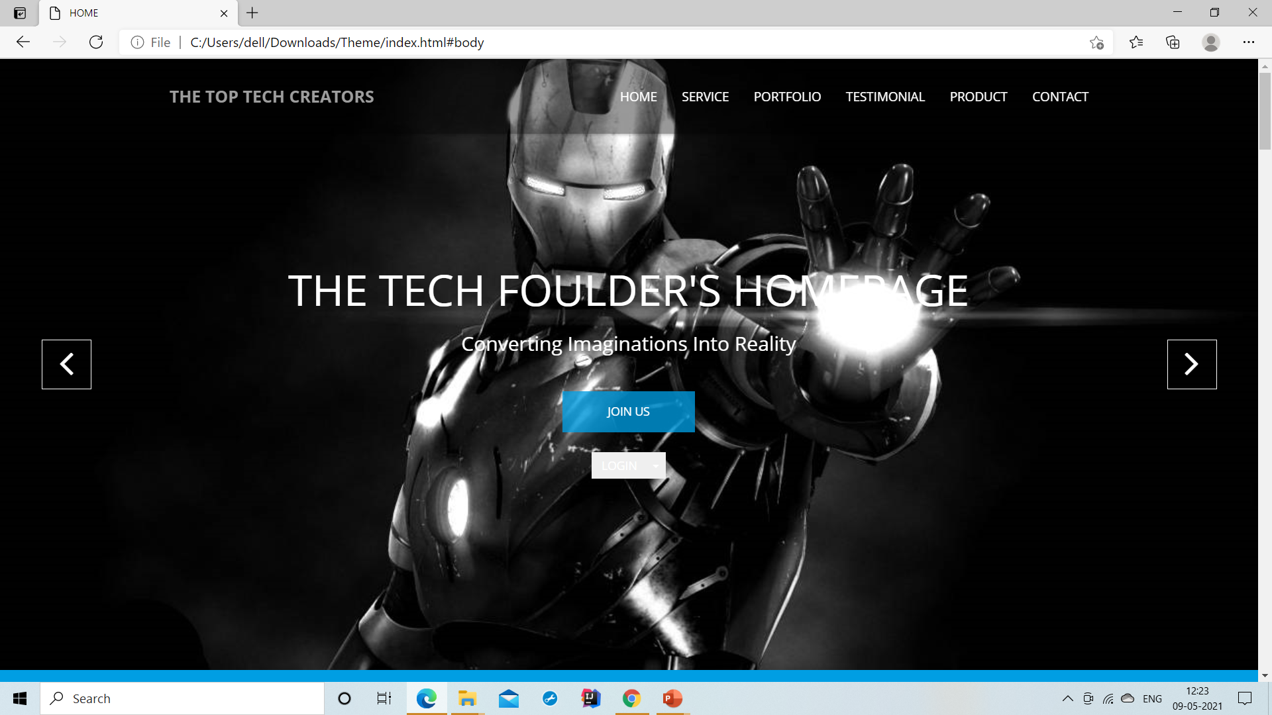
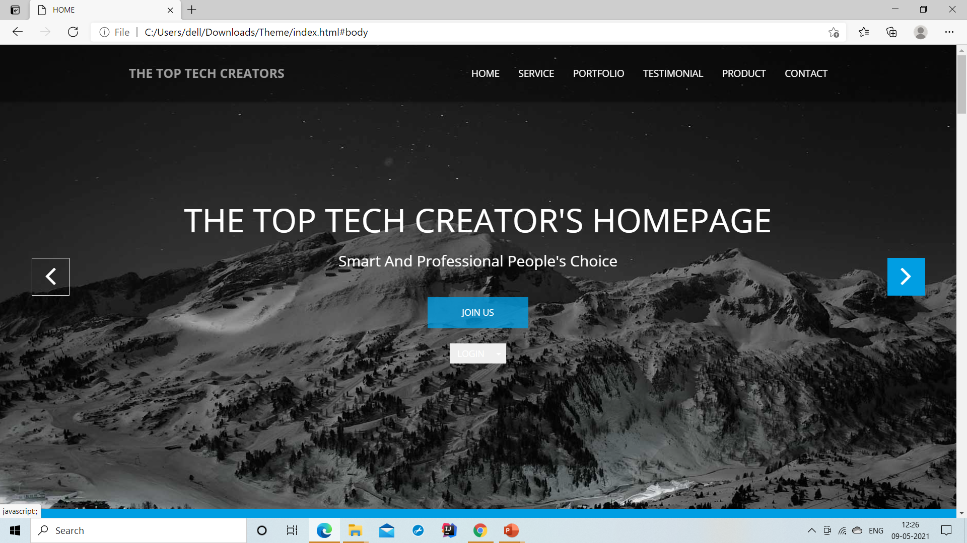
Home Screen

Slide 8
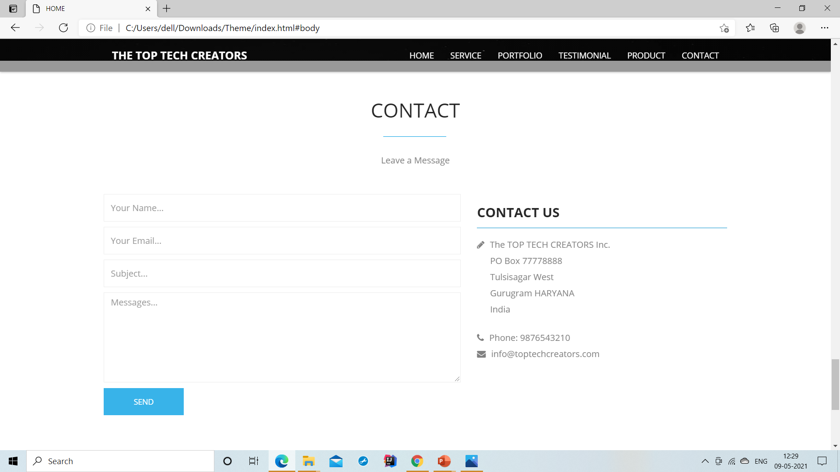
Login Page

Slide 9
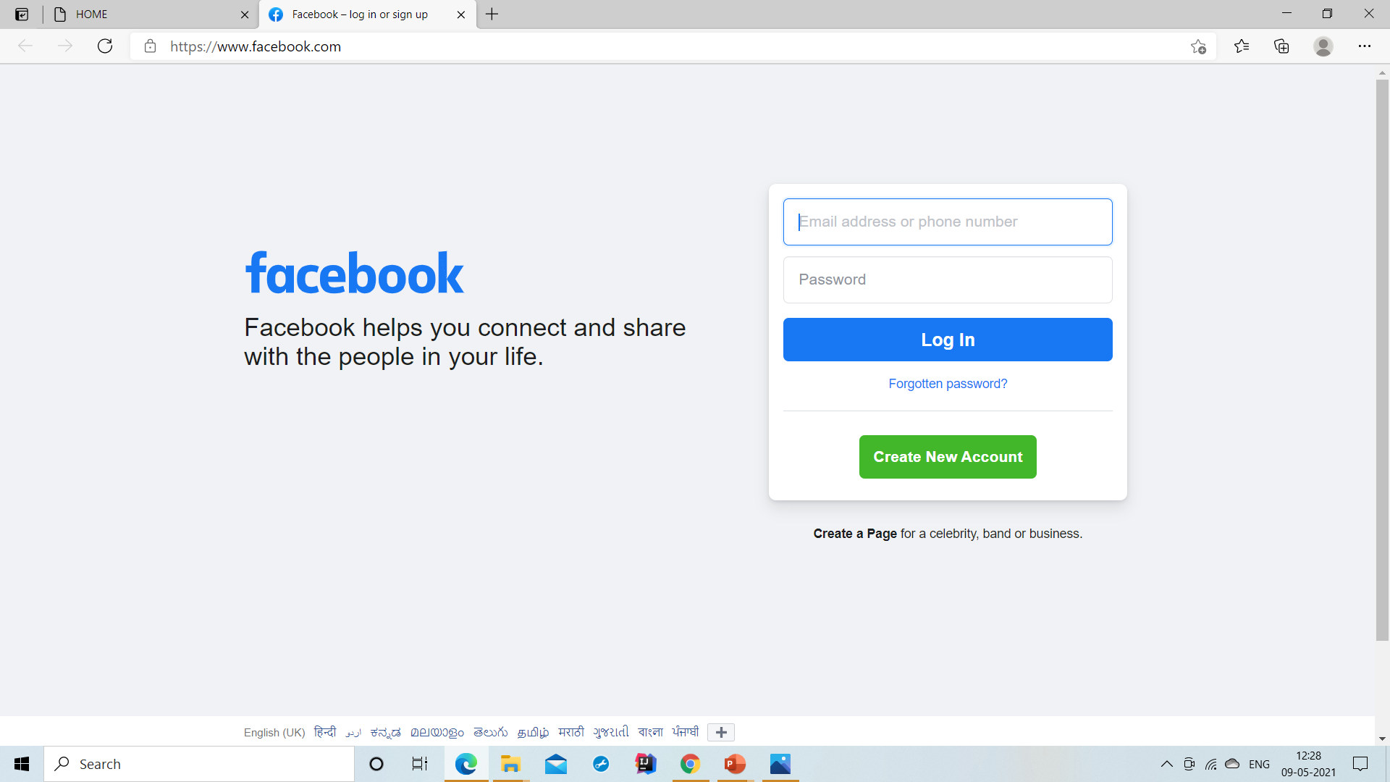
Validation

Slide 10
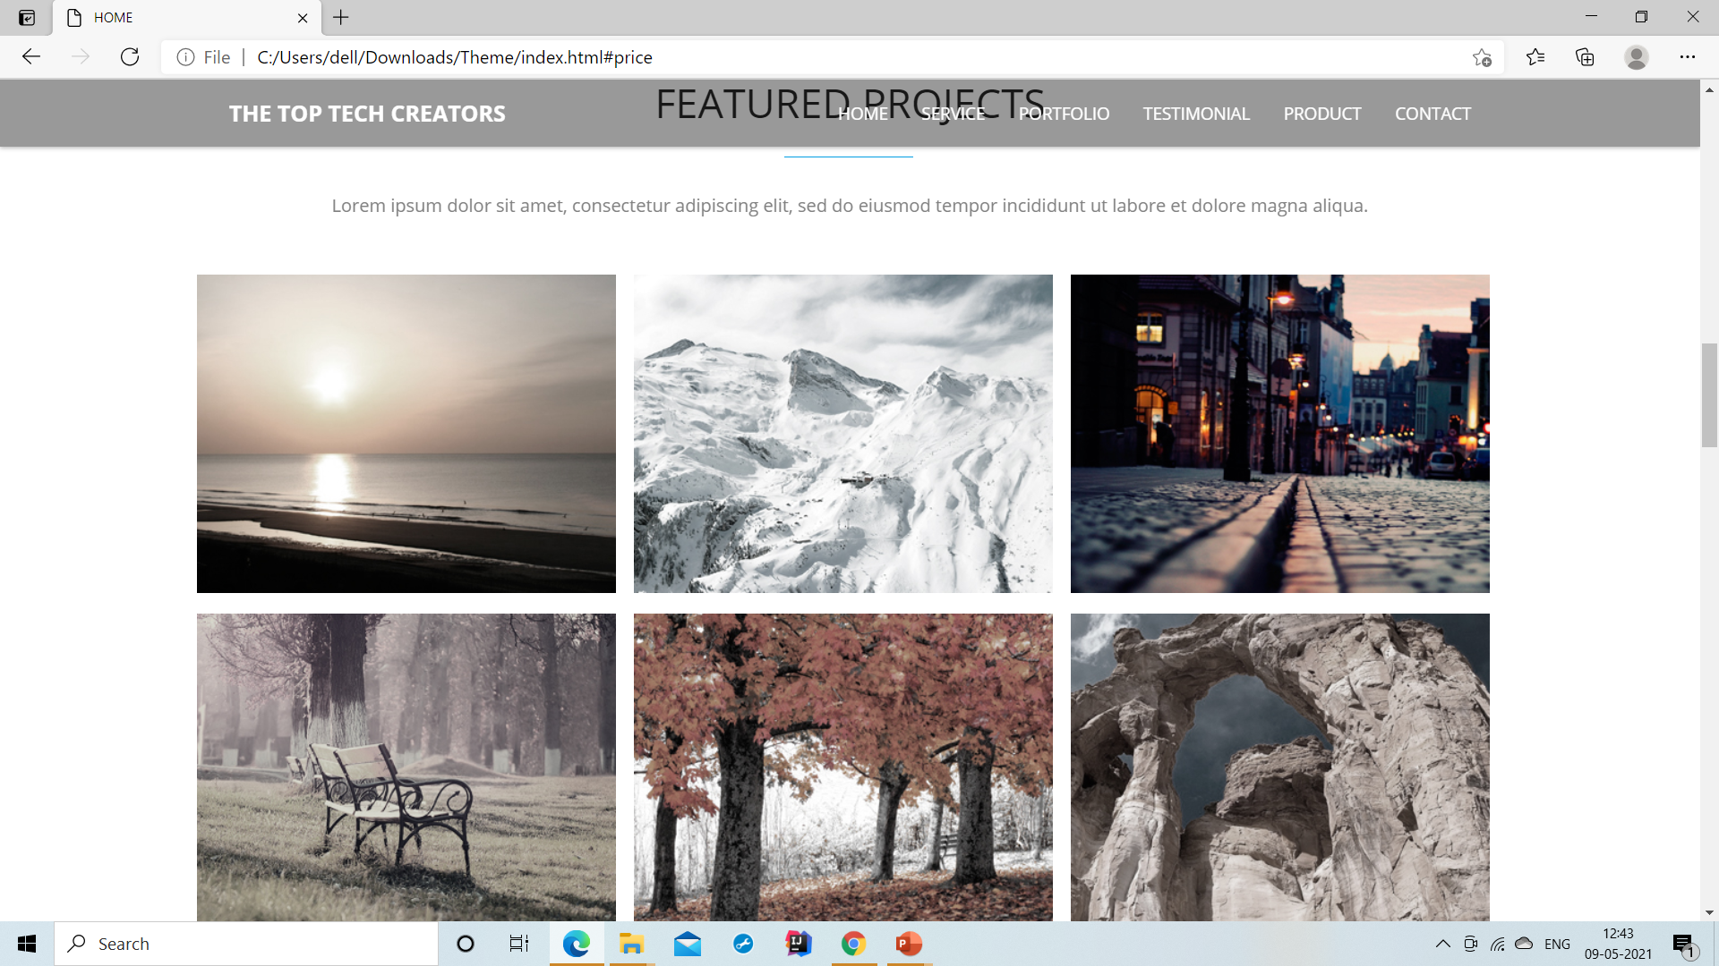
FEATURED PROJECTS:

Slide 11
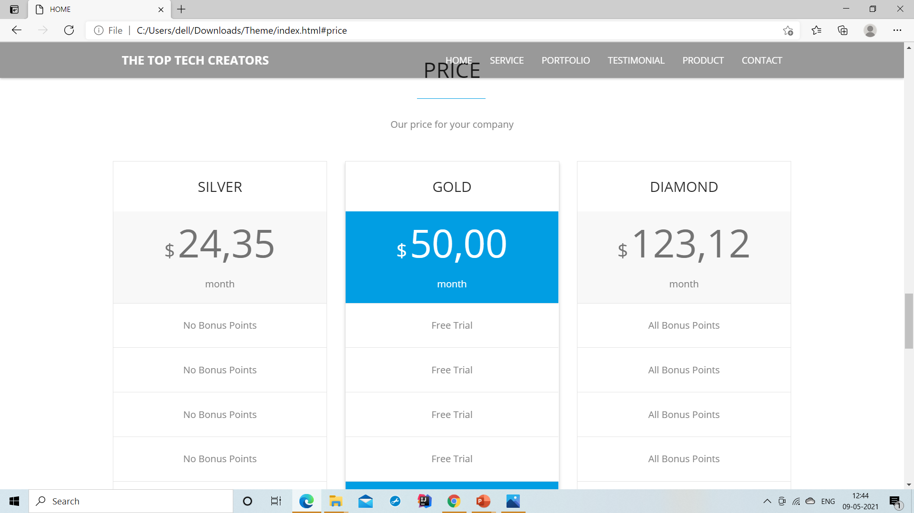
Add Product

Slide 12
Advantages
It can help increase Profits .it can Increase sales Decrease costs.
It can Increase flexibility and ease of shopping for customer.
It can help In low operational Cost means we can deploy our website on any platform like Heroku, Firebase , Aws in low cost.
Customer can Purchase any Product from Single place in Reasonable Price and get their product in within 7 days.
Customer can return the Product in 7 days return policy.

Slide 13
Disadvantages
Biggest Disadvantage is it is Internet Driven .No body can access this website without internet connection.
The customer cannot touch or feel the Product.
The Customer has to wait for the Delivery of Product.
Sometimes the reviews can created the manually to lure the customer to buy the Product with wrong Intention of selling.

Slide 14
Future Scope
We will Add the Online Payment Mode for user in this website.
We will Make this Website on Multiple vendor basis So that multiple vendor can open their shops on this website and sell their product in reasonable price.
We will store the data in Mongo DB later on.
We will add the recommendation system in this website means website will recommend the product which has a high sell in last few days.

Slide 15
References
https://www.coursera.org/learn/html
https://www.coursera.org/learn/introcss
https://www.w3schools.com/js/DEFAULT.asp
https://www.youtube.com/watch?v=Qqx_wzMmFeA
https://www.w3schools.com/nodejs/ref_modules.asp

Slide 16
Conclusion
The Internet has opened so many opportunities for doing business online, and E-commerce is one of the best fit in this scenario.
Not only does it require low requirement but also it actually is a type of business that does not require full time commitment of Product.
It is best strategy to capture the market in less time and sell product the in anywhere in the corner of our world.
If user do not want to order any product then he/she can leave the website .there is not any compulsion to purchase any Product.
We use Firebase for authentication and firebase cloud store for store the order and products and HTML,CSS JAVASCRIPT and BOOTSTRAP for UI of this website.

Slide 17
THANK YOU.

